Slide 1
How to develop and deliver a long-term security strategy for Office 365 that works !
(AKA: security for the IT-Pro)
Michael Van Horenbeeck

Slide 2

Michael Van Horenbeeck
Managing Partner | The Collective
Offices Apps & Services MVP
Security/EMS afficionado
@vanhybrid

Slide 3
“There’s two types of organizations: those who have been hacked, and those who don’t know it yet...”
John T. Chambers

Slide 4
Importance of a strategy
Implementing solutions for the sake of implementing them is (rarely) a good idea.
Adding products and features to your solution stack often means adding complexity which can affect your security/compliance baseline (negatively).
Notes:
“Find your why”

Slide 5
Identify/enumerate risks/threats
Identify threats that are applicable for your organization and ‘common’ in the industry. For example:
Is there a high(er) risk of Data Loss (e.g. corporate espionage)?
What workloads will you be using?

Slide 6
Build your own Threat Matrix
What is the threat/risk?
What would the impact of the threat be?
How likely is it going to occur (probability)?
How can I mitigate the risk? Is there more than one approach?
What is the cost of implementing the solution? (both licensing and effort)

Slide 7
Example
Threat | Impact | Probability | Possible solution(s)
Ability to (inadvertently) share sensitive information with a non-authorized 3rd-party (via email). | High | Medium | Prevent automatic forwarding Implement Rights Management Office Message Encryption Implement Session Controls ....

Slide 8
Threats/Risks have many forms
Data Theft / Data Loss
Malicious software (malware, ransomware)
Phishing
Regulations
...

Slide 9
Compliance
Internal/External compliance requirements add a layer of complexity:
GDPR, EAVG,...
HIPAA (US)
ISO
PCI DSS (Payment Card Industry)
...

Slide 10
Type of measures
Not all threats need to/can be mitigated with a (technical) solution.
Organizational measures (e.g. procedures) can be effective too.
e.g. User training/awareness
IT Policy

Slide 11
Framework?
Various frameworks exist to aid developing a security strategy. Choose which one fits you best (if any). Ideally, combine them.
Protect
Detect
Respond
ICT maturity level
Low
High
Notes:
Talk about MITRE ATT&CK, NIST CyberSecurity Framework, ISO, PCI DSS, etc...
John Lambert’s Office 365 Attack Techniques

Slide 12
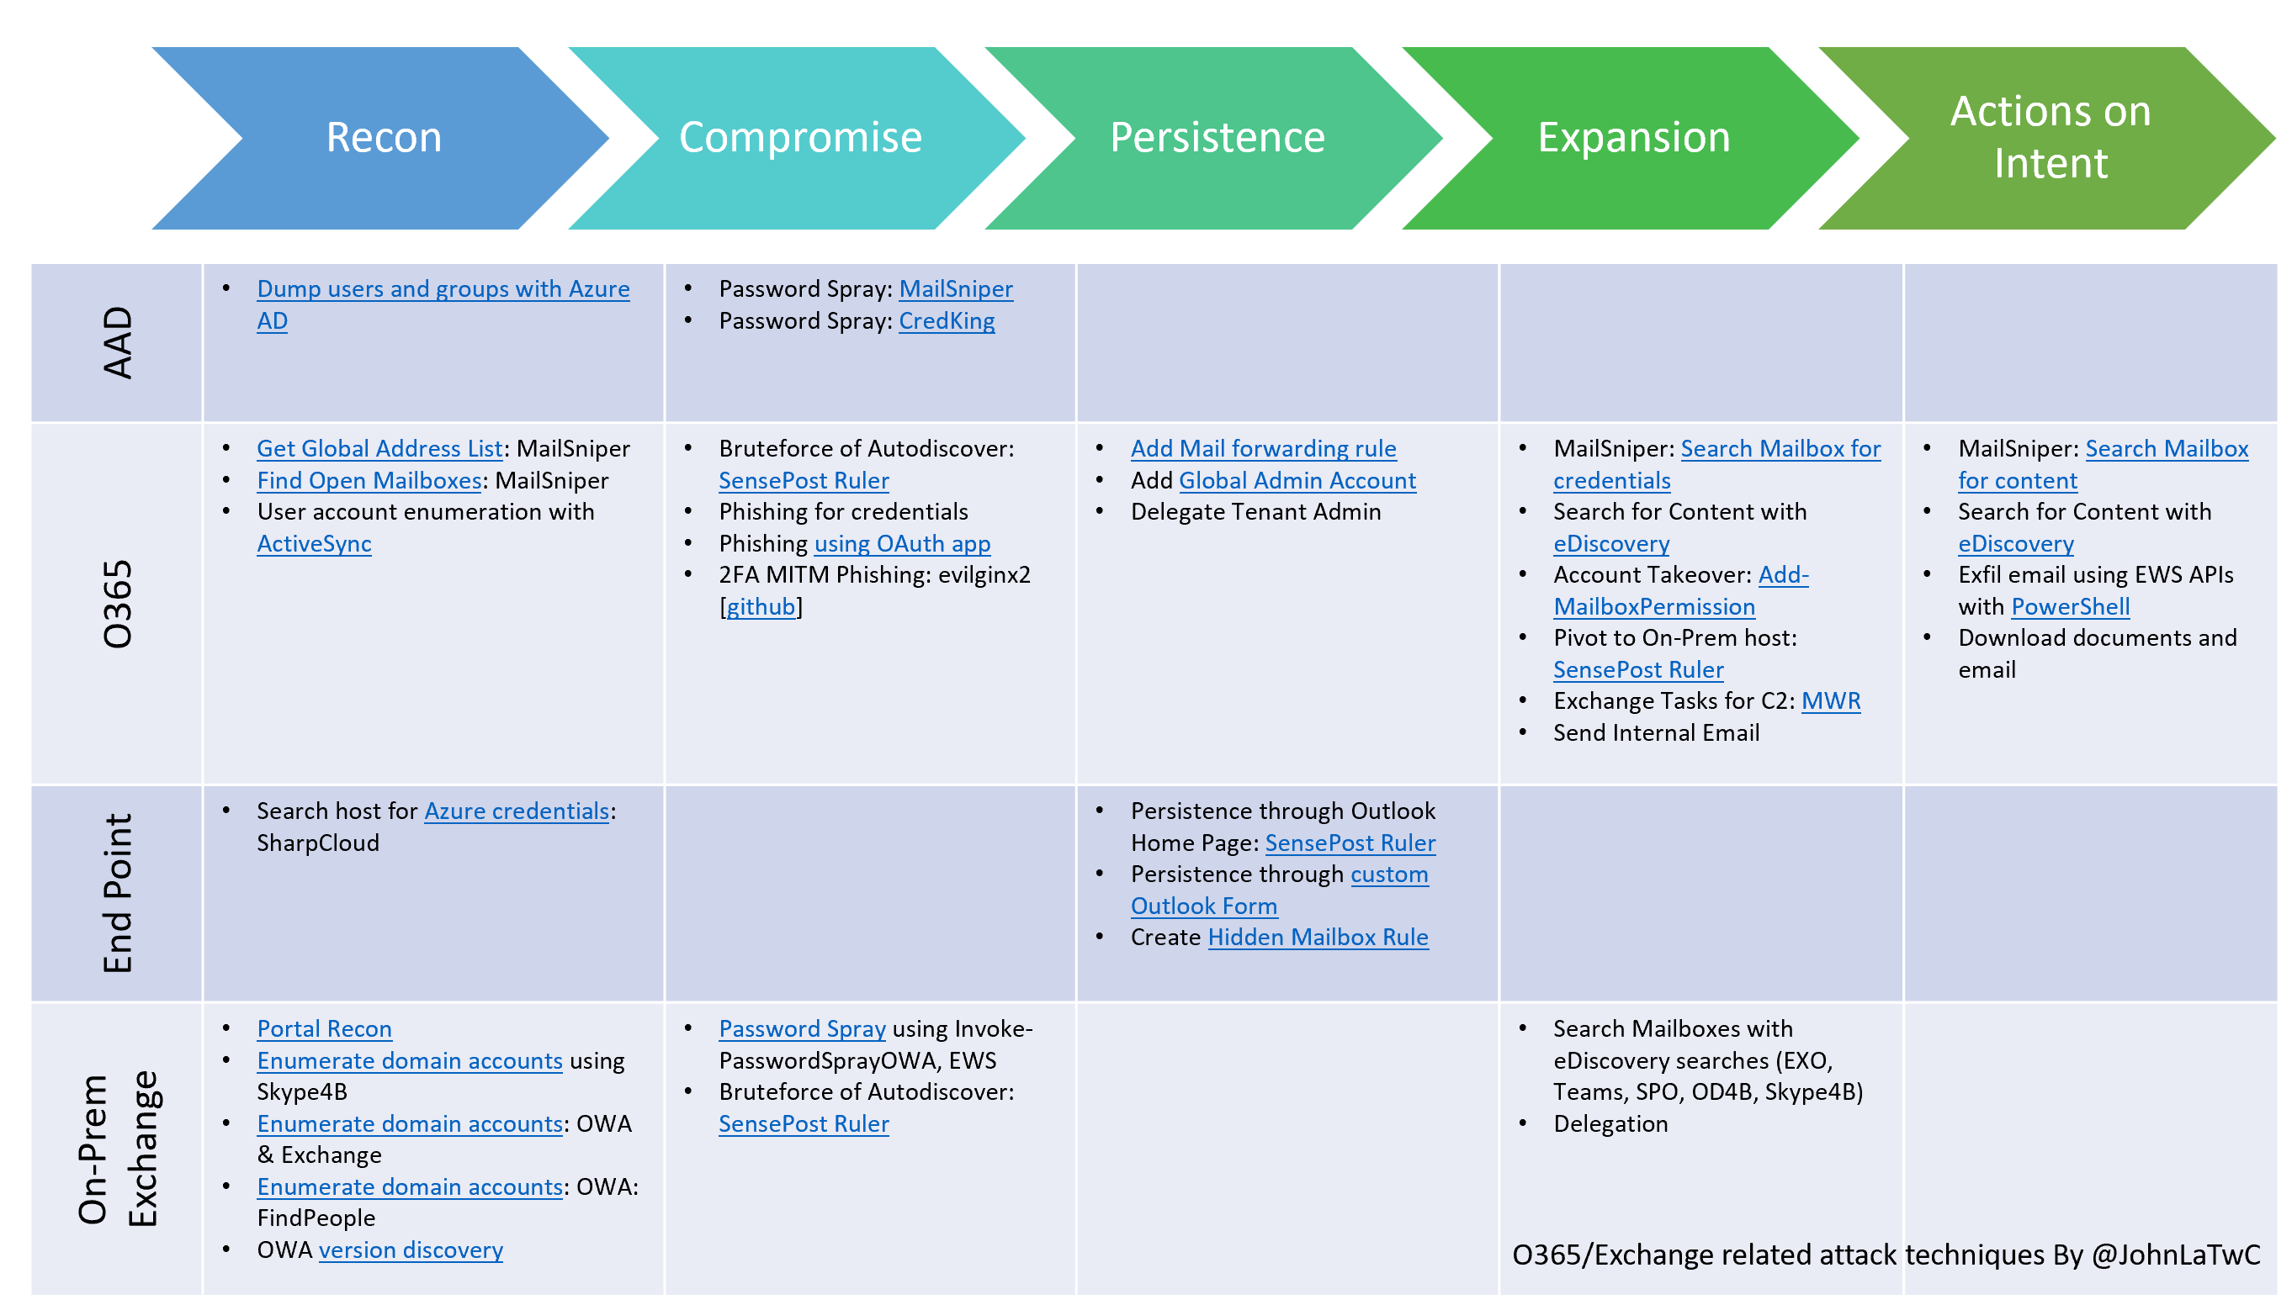
Notes:
John Lambert’s Office 365 Attack Techniques

Slide 13
Protect (prevention)
Make sure to cover as much as you (reasonably) can; it will keep out 90%+ of the threats.
Examples are:
DLP policies
Azure Information Protection
…
Notes:
Yes, I made up that number ☺

Slide 14
Detect
Effective en intelligent detection mechanisms can help you minimize damages of a breach and will reduce the time to counteract.
Measure for gaps in your protection strategy first.
e.g. Windows Defender ATP
SIEM-integration (e.g. Sentinel)
Notes:
You’d be a fool to believe that solely investing in prevention will keep you safe...

Slide 15
Respond
Make sure to have appropriate tools and processes in place to tackle a problem head-on.

Slide 16
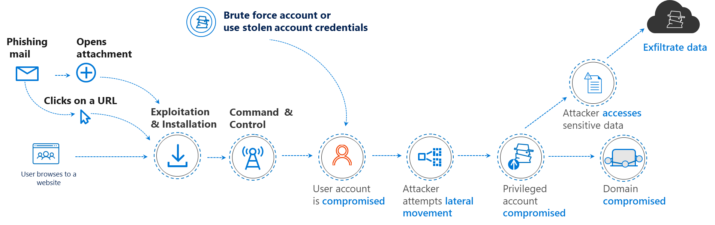
Cloud App Security
Azure AD Identity Protection
Office 365 ATP
Defender
ATP
Azure ATP
Notes:
Image courtesy of Microsoft.

Slide 17
What to focus on?
Depending on your current security posture, you might want to first spend (most) efforts on developing a good/thorough defense strategy (protect)

Slide 18
What to watch out for?
There is a balance between cost & effectiveness.
Some features may offer a solution, but may end up costing too much (vs. the risk exposure); proportionality principle
e.g. Is it really worth spending 1million to protect assets worth 100k?*
Pareto principle also applies to cybersecurity...

Slide 19
Identifying threats & defining countermeasures

Slide 20
Exchange Online
Threat | Possible solution(s)
Ability to (inadvertently) share sensitive information with a non-authorized 3rd-party (via email). Manual or automatic action. | Prevent automatic forwarding Implement Rights Management Office Message Encryption Implement Session Controls ....

Slide 21
Exchange Online
Threat | Possible solution(s)
Potential to receive harmful payloads (e.g. Malware) via email. | Implement Office 365 ATP Implement Windows Defender ATP Implement Azure Sentinel

Slide 22
Exchange Online
Threat | Possible solution(s)
Potential to receive spoofed messages in order to trick users to 1) perform unauthorized actions or 2) click malicious links (to download payload). | Implement Office 365 ATP User awareness training

Slide 23
Exchange Online/SPO
Threat | Possible solution(s)
Weak identification of the recipient (which may lead to unintended disclosure of sensitive information). | Implement Rights Management (w/ ability to revoke content) User awareness Leverage Global Address list Monitoring / Supervision policies ....

Slide 24
Exchange Online
Threat | Possible solution(s)
Potential data exfiltration through Outlook (fat client) | Disallow users to connect multiple accounts in Outlook. Implement rights management

Slide 25
Exchange Online
Threat | Possible solution(s)
Potential data exfiltration through Outlook by synchronizing contents onto an insecure device (OST/PST) | Conditional Access (only allow managed devices); limit downloading of files through managed devices only Disable ability to take files offline in Outlook Web App

Slide 26
Exchange Online
Threat | Possible solution(s)
Potential reputational damage because of spoofed domains | Implement DKIM and DMARC Use S/MIME Use Office Message Encryption

Slide 27
Exchange Online
Threat | Possible solution(s)
Lack of probative value of correspondence | Keep message tracking logs Use Office Message Encryption Use DKIM/DMARC (and monitor!)

Slide 28
SharePoint Online / ODfB
Threat | Possible solution(s)
Ability to (inadvertently) share sensitive information with a non-authorized 3rd-party. | Disallow external sharing Create specific site(s) or libraries through which sharing is possible. Implement Rights Management Implement DLP Policies Monitoring (SecOps) Auditing & Reporting (e.g. whom has shared what)

Slide 29
SharePoint Online / ODfB
Threat | Possible solution(s)
Users can potentially upload/download harmful payloads (e.g. Malware) | Implement Office 365 ATP Deploy Defender ATP Monitoring & Reporting

Slide 30
SharePoint Online / ODfB
Threat | Possible solution(s)
Potential data exfiltration (to insecure devices) through synchronizations mechanisms | Prevent synchronization (completely, partially) Implement Conditional Access User Cloud App Security Session policies

Slide 31
Authentication
Threat | Possible solution(s)
Risk of (successful) brute force attacks | Relax the security restrictions... Cloud App Security (broker for cloud applications) Deploy MDATP (monitoring) User awareness training

Slide 32
Authentication
Threat | Possible solution(s)
Use of insecure passwords | Implement (strong) password policy Enforce MFA Block Legacy authentication Implement Password Hash Synchronization (for Insecure Password Detection)

Slide 33
Authentication (ADFS)
Threat | Possible solution(s)
Risk of being victim of a DDOS attack | Implement DDOS mitigation solutions (also processes!) Highly-available setup of ADFS Have backup strategy available (e.g. tunnel all traffic if external access to ADFS is unavailable)

Slide 34
Teams
Threat | Possible solution(s)
External users may have access inadvertently access to sensitive data | User awareness training Implement Rights Management Prevent external sharing Implement Cloud App Security session controls.

Slide 35
Flow
Threat | Possible solution(s)
Ability to exfiltrate data through Flow, despite DLP policies. Flow DLP policies prevent sharing data across e.g. Different connectors, but it won’t stop you from reading an email and then forwarding it. | User awareness Implement Rights Management

Slide 36
General
Threat | Possible solution(s)
Rogue admin | Implement Privileged Identity Management Proactive monitoring, reporting and alerting Implement Alert Policy in SIEM or CAS to alert when high-privileged account is (mis)-used Conditional Access to restrict usage of privileged accounts

Slide 37
General
Threat | Possible solution(s)
Accidental misconfiguration by privileged accounts | Implement Privileged Identity Management Use automation where possible (manual actions increase the risk) Abide to the principe of least privilege > RBAC, Privileged Access Management

Slide 38
General
Threat | Possible solution(s)
Risk of introducing (more) Shadow IT by a (too) restrictive approach of the security countermeasures; no visibility in current shadow it usage | Relax the security restrictions... Cloud App Security (broker for cloud applications) Deploy MDATP (monitoring) User awareness training

Slide 39
General
Threat | Possible solution(s)
When installing Office Pro Plus on a computer at home, data might be inadvertently visible. | User education Block download/installation of Office from portal Implement Conditional Access

Slide 40
General
Threat | Possible solution(s)
User registers 3rd-party application which could exfiltrate user data | Turn off user consents in Azure AD

Slide 41
Other
Threat | Possible solution(s)
Microsoft has the potential to access customer data. | Implement Customer Lockbox Implement Customer Key (Service Encryption)

Slide 42
Other
Threat | Possible solution(s)
Foreign (US) government might subpoena Microsoft for proprietary information. | Don’t move such data into Office 365... (Customer Key only mitigates unauthorized snooping)

Slide 43
Other
Threat | Possible solution(s)
Unavailability of the Azure Information Protection client | Monitoring Implement Defender ATP + Azure Information Protection analytics

Slide 44
Other
Threat | Possible solution(s)
DLP policies don’t apply immediately to newly-uploaded documents; there might be a (significant) delay | Implement Cloud App Security (e.g. Session controls) Implement Rights Management (document-level)

Slide 45
Workstation
Threat | Possible solution(s)
Default antivirus not sufficient to deal with zero-day threaths and advanced malware | Implement Defender ATP Integrate with e.g. Cloud App Security Enhance w/ Intune Compliance Policy

Slide 46
Workstation
Threat | Possible solution(s)
Windows attack surface | Implement Intune (Security Baseline policy) Defender ATP (Attack Surface Reduction Rules) For Azure VMs > Azure Security Center

Slide 47
GDPR
Threat | Possible solution(s)
Users have access to the Azure Portal through which they may be able to (easily) see other user information and/or resource information | Restrict access to the Azure Portal for users Implement Conditional Access / Cloud App Security to restrict access to the feature

Slide 48
GDPR
Threat | Possible solution(s)
Personal data potentially captured without consent (and available to users) when using ‘Track & Trace’ in Azure Information Protection | Prevent automatic forwarding Implement Rights Management Office Message Encryption Implement Session Controls ....

Slide 49
GDPR
Threat | Possible solution(s)
Personal information of guest accounts centrally stored in Azure AD (no lifecycle by default). Data is potentially captured without prior consent. | Prevent automatic forwarding Implement Rights Management Office Message Encryption Implement Session Controls ....

Slide 50
Are you GDPR compliant?*
GDPR is not just about implementing (technical) solutions to specific threats/scenarios.
It’s also (more) about having proper controls/processes in place to deal with subject privacy. Technical solutions aid in abiding to those controls/processes.

Slide 51
Maintaining your strategy

Slide 52
It’s a moving target...
Define a roadmap (fit-gap)
Update the roadmap regularly (in function of new features, updates, etc.)

Slide 53
TL;DL

Slide 54
Key Points
Start by defining threats applicable to your organization/data... Define solutions from there.
Make sure to cover all cycles(protect, detect, respond)
Regularly revisit your strategy/roadmap as features are updated and new capabilities/solutions introduced.

Slide 55
Next session: 11:30AM – 12:30PM
Infrastructure as Code; Azure Resource Manager - inside out
Henry Been

